Slide 1



HATE SPEECH DETECTION.
Hate speech detection aims to identify and mitigate the use of language that promotes hatred and prejudice towards specific groups or individuals (Using Natural Language Processing).
PRESENTERS:-
Ketki Thaware (0111)
Mayuri Potbhare (0112)
Mitali Karande (0113)
Prajakta Gondule (0114)
Rutika Chakole (0115)
Guide:- Dr.A.C Kailuke.

Slide 2
Objective and scope:
Text Analysis
Applications
Scope:
NLP involves the analysis of human language, enabling computers to understand, interpret, and respond to natural language data.
NLP is used in a wide range of applications, including language translation, sentiment analysis, and speech recognition.
Is to identify and categorize text that contains hateful or discriminatory language towards individuals or groups based on attributes such as race, ethnicity, religion, gender, sexual orientation, disability, etc.

Slide 3
LITERATURE REVIEW:
PLATFORMS
ABSTRACT
AUTHORS
Semantic Web.
Aims to classify Textual content into non-hate ot hate speech in which the case the method may also idientify the taregting characteristics in hate speech.
Ziqi Zhang.
Science Direct.
This paper provides semantics reveiw of literacture in this feild with focus on nlp.
Md Saroar jahan.
ACM Digital Library.
The increase in hatefull content online has motivated resaarch in automatic approches for detecting hate speech.
Aman khullar.
Research Gate
The exponential Growth of social media such as twitter and community forums has revolutionised propogation of hate speech and organisation of hate based activites.
Areej Al Hassan.
Papers with code
Based on prejudice agianst protected characteristics such ethincity,gender,religion,age etc
Michael best.

Slide 4
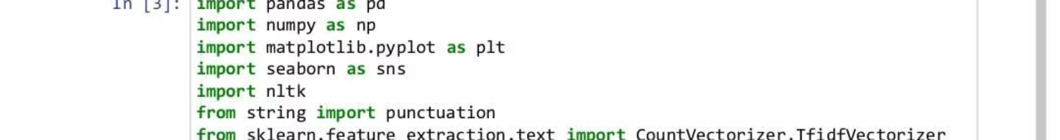
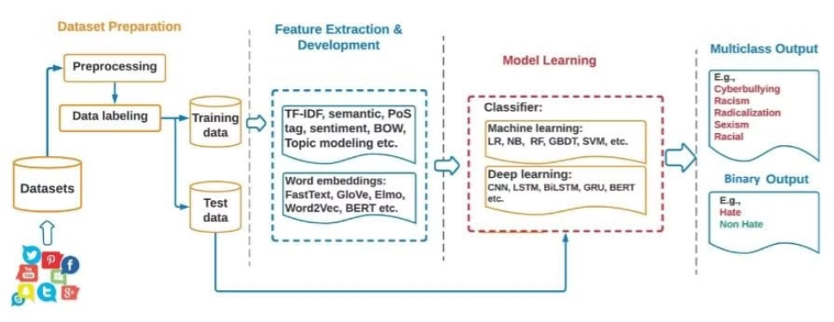
METHODOLOGY:
The methodology for hate speech detection on Twitter using NLP involves data collection of labeled tweets, preprocessing to clean and tokenize the text, feature extraction to convert text into numerical features, model selection of machine learning or deep learning models, training the model on a labeled dataset, and evaluation of the model's performance using metrics such as accuracy, precision, recall, and F1-score. Various NLP techniques and models can be employed, such as TF-IDF, Word2Vec, GloVe, Logistic Regression, SVM, LSTM, or Transformer-based models like BERT or RoBERTa, to effectively detect hate speech on Twitter and improve online safety and moderation.

Slide 5
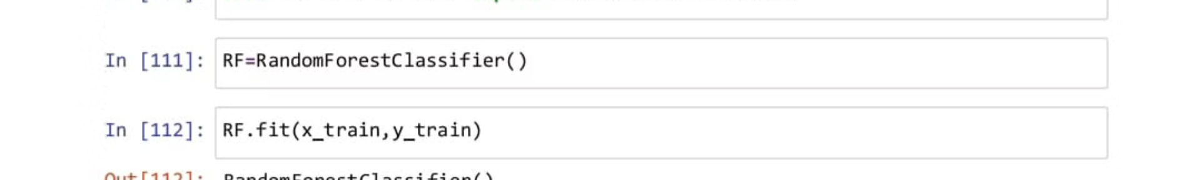



EXPECTED OUTCOMES &IMPACTS :
Improving Accuracy
Enhance models to reduce false positives and false negatives.
Real-Time Detection
Develop systems capable of instantaneous hate speech identification and prevention.
Linguistic Nuance Capture
Refine models to detect the complexity of subtle hate speech expressions.

Slide 6
OUTPUT :
1
2
3
4
5

